Slide 1
Online Shopper Intention Data
Data Analysis & Predictive Model Project

Slide 2
Exploratory Data Analysis
Data Structure – 12330 rows * 18 Columns
Data had 125 duplicated rows
No Missing value found in dataset
After removing duplicated rows final structure – 12205 rows * 18 columns
All duplicated value were from Non-revenue generating Visitors
Features :
Target/ Dependent Variable - Revenue (Binary class)
Independent Variables
Discrete Numerical Features - 'Administrative', 'Informational', 'ProductRelated’
Continuous Numerical Features - 'Administrative_Duration', 'Informational_Duration', 'ProductRelated_Duration', 'BounceRates in %', 'ExitRates in % ', 'PageValues', 'SpecialDay (probability)’
Categorical Features - 'Month', 'VisitorType', 'Weekend', 'OperatingSystems', 'Browser', 'Region', 'TrafficType'

Slide 3
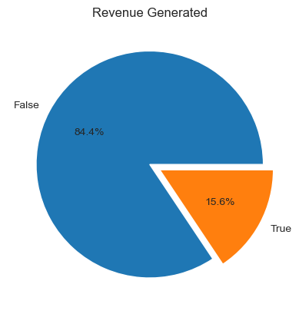
Revenue
Out of 12205 visitors, only 15% of visitors are purchasing.
Dataset is highly imbalanced. Built model will be biased.
We will oversample the minority class to create a balanced data.

Slide 4
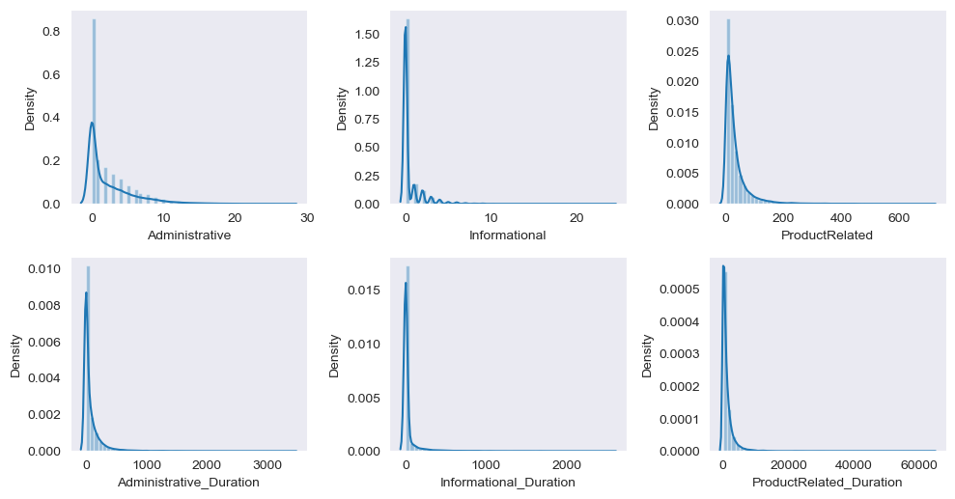
Distribution of different Pages and their duration
Most visitors have visited initial pages.
Most visitors have visited for less duration.
Data is not Normal distributed.

Slide 5
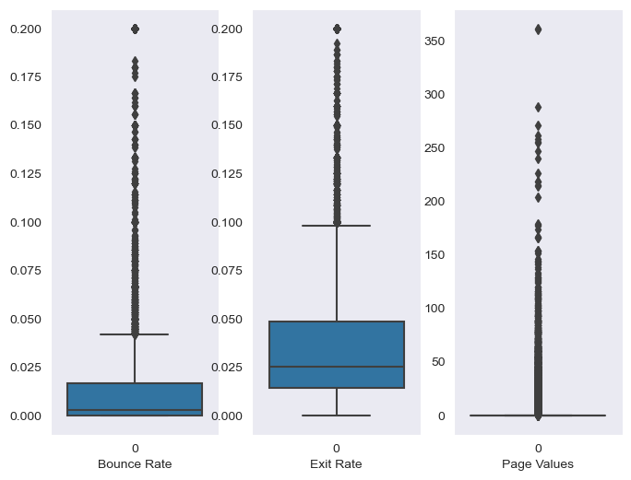
Page Metrics Analysis
75% data points, bounce rate are below .05, it means visitors are visiting multiple pages
50% data point of exit rate are below 0.05
Data is right skewed and have outliers.
The average Bounce and Exit rate is low which is good

Slide 6
Administrative Page Analysis

Slide 7
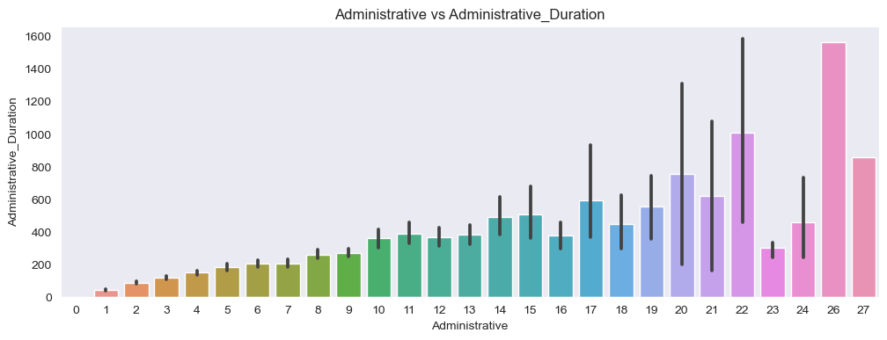
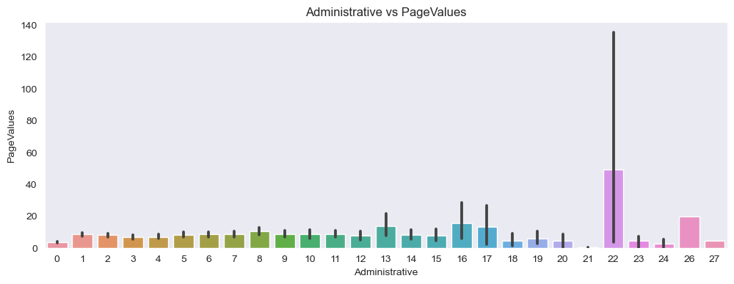
Administrative Page vs Duration
Average spent time is increasing as Administrative page no. is increasing. Page 26, 22 and 27 are in Top 3.
Administrative Page vs PageValues
Average Page value is high for page 22. rest pages have mostly uniform value.

Slide 8
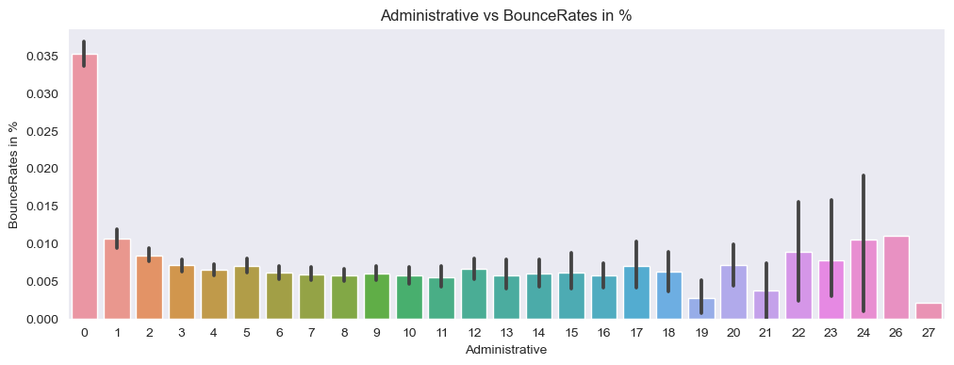
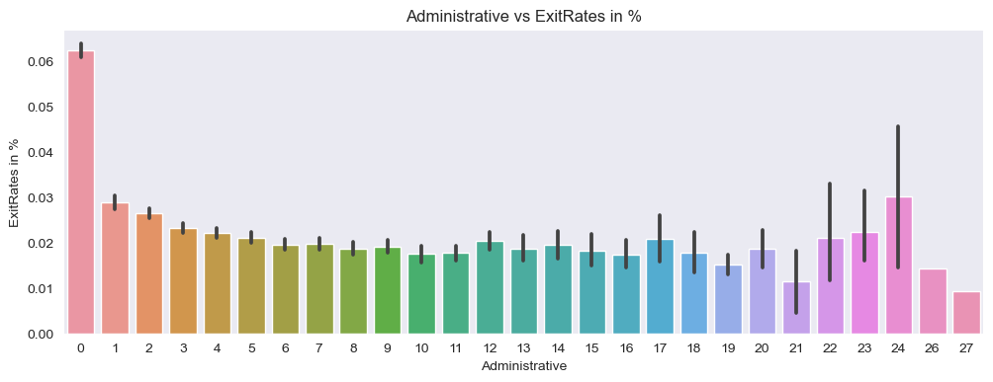
Administrative Page vs Bounce Rate
Average Bounce rate is approx uniform. Those visitor who doesn't have visited any Administrative page bounce rate is high.
Administrative Page vs Exit Rate
Average Exit rate is approx uniform.

Slide 9
Informational Page Analysis

Slide 10
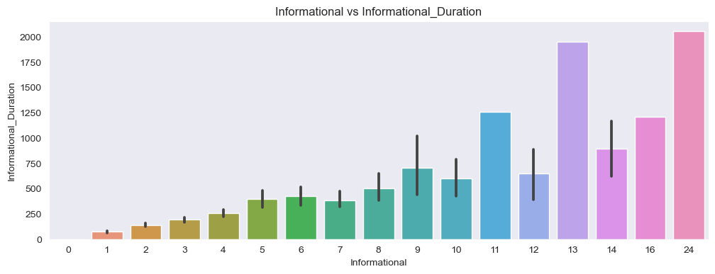
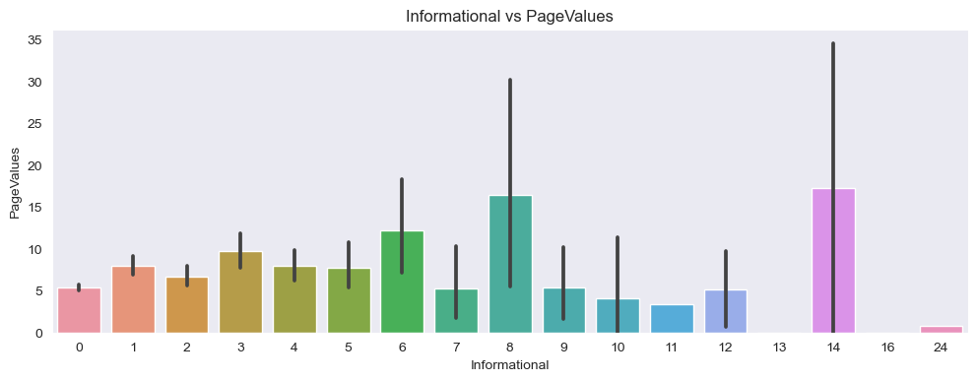
Informational Page vs Duration
Average duration is increasing as page number is increasing. Top 3 pages are 24, 13 and 12.
Informational Page vs PageValues
Average Page value for page 14 and 8 is high among other pages.

Slide 11
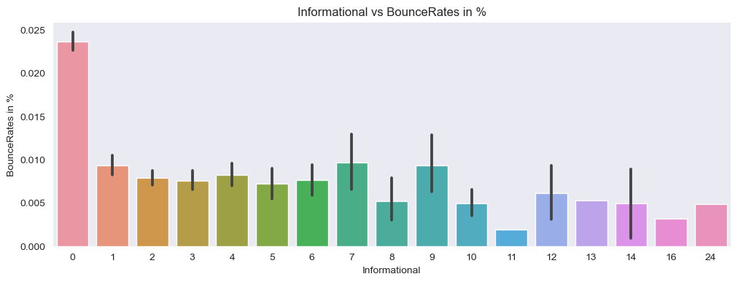
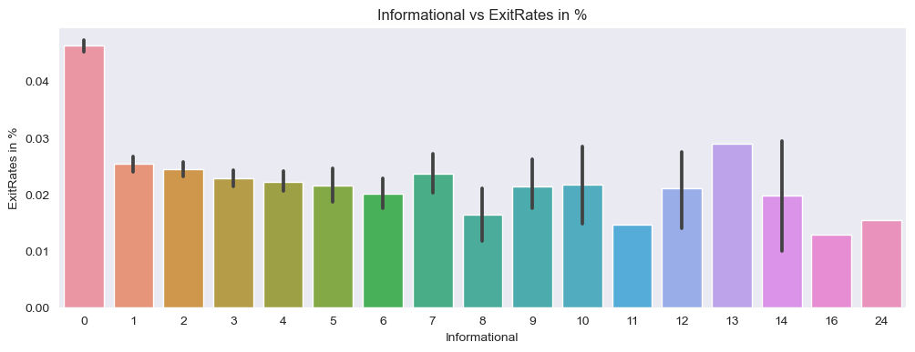
Informational Page vs Bounce Rate
Average Bounce rate is decreasing as the page number is increasing.
Informational Page vs Exit Rate
No clear relation.

Slide 12
Product related Page Analysis

Slide 13
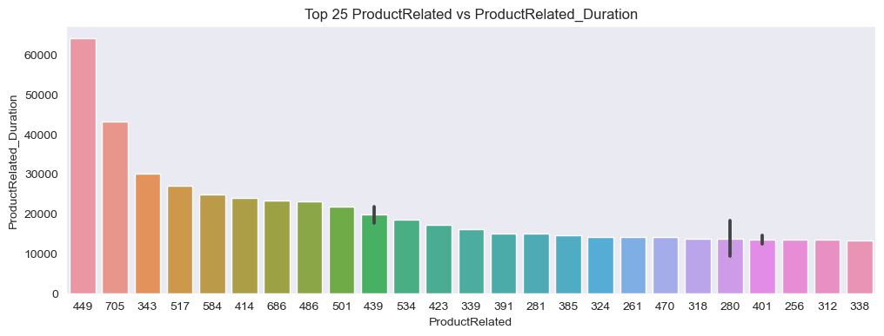
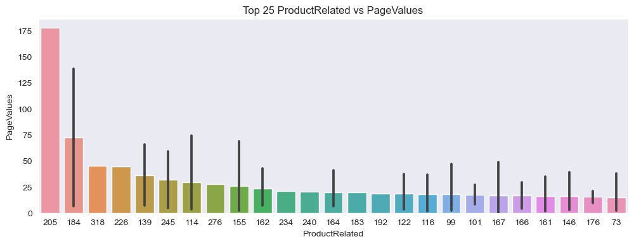
Top 25 Product Related Page vs Duration
Average Time Spent on Product pages are much higher than Admin or informational pages.
Top 25 Product Related Page vs Page Values
Product page 205 has the highest average Page value.

Slide 14
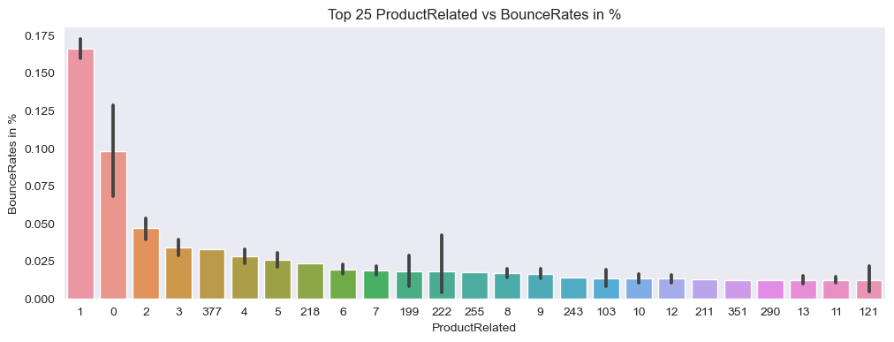
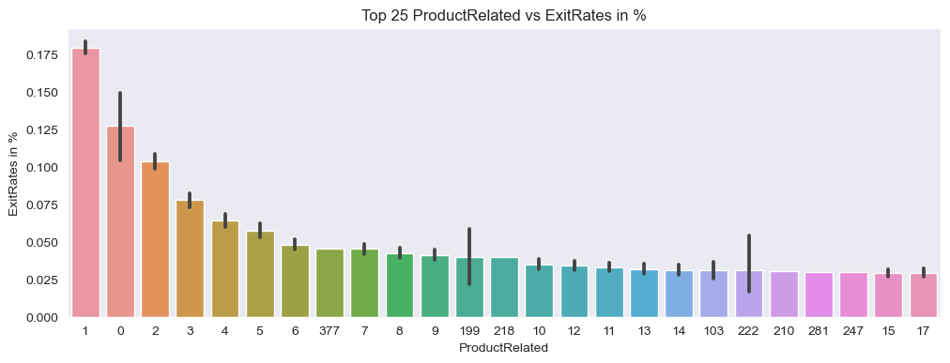
Top 25 Product Related Page vs Bounce Rate
Top 3 average Bounce rate pages are initial pages 1, 2 and 3.
Top 25 Product Related Page vs Bounce Rate
Top 3 average Exit rate pages are initial pages 1, 2 and 3.

Slide 15
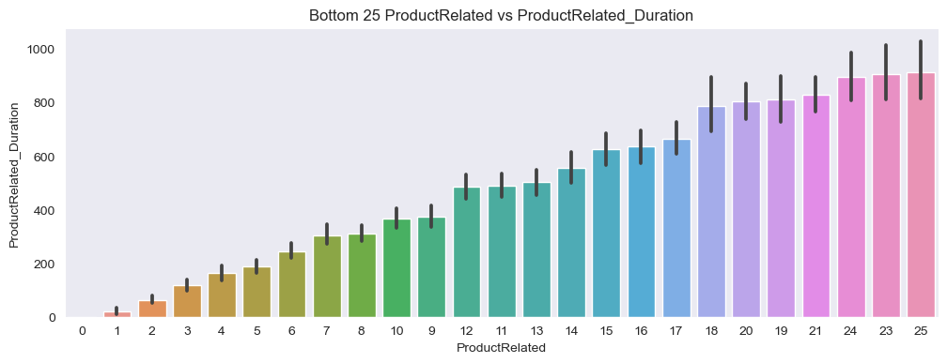
Bottom 25 - Product Related Page vs Duration
Product related page and spent duration have strong Positive relation.
Initial pages 1,2 and 3 have the least spent duration and they high bounce and exit rate.
47 product pages have generated zero revenue in spite of having visitors.

Slide 16
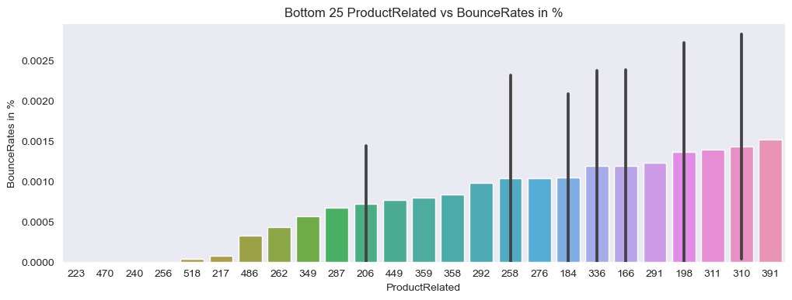
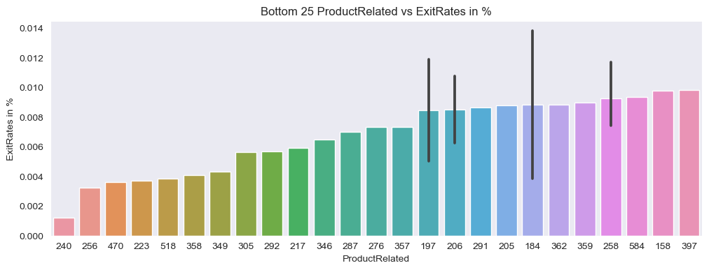
Bottom 25 Product Related Page vs Bounce Rate
Page 223, 470, 240 and 256 have almost zero average bounce rate.
Bottom 25 Product Related Page vs Exit Rate
Page 240 have the least exit rate.
Product Page 240 is also in Top 25 PageValue.

Slide 17
Revenue Analysis with Different Category

Slide 18
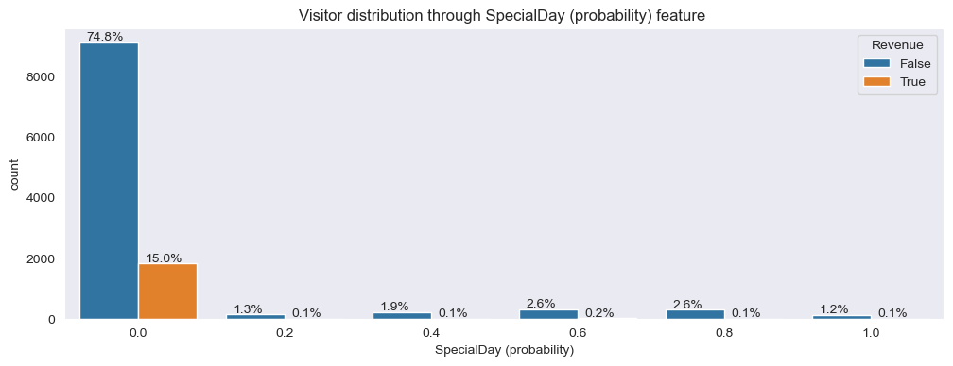
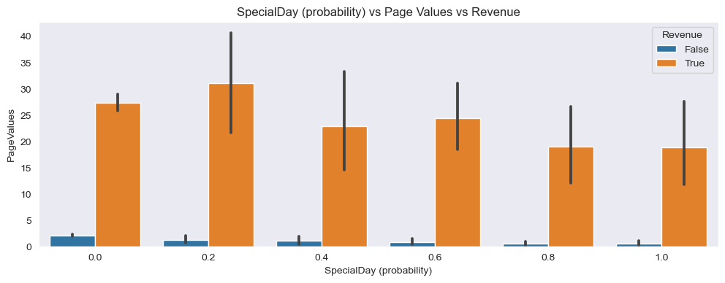
Special Day
90% visitors came on normal days.
Inspite of having less visitors on Special days, revenue is almost same.
People are more buying on Special days. May be because of sales and festive.

Slide 19
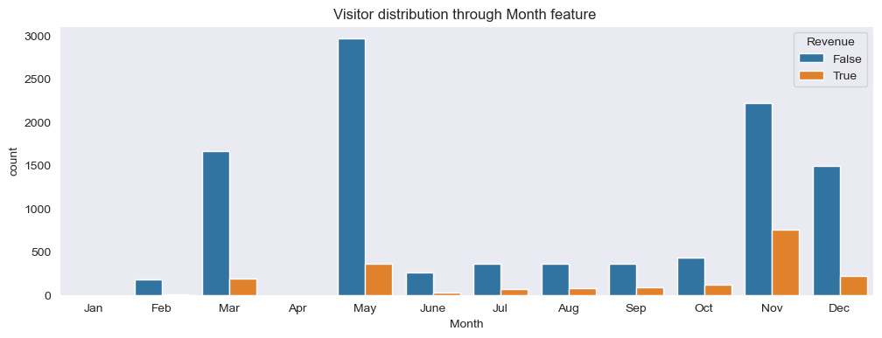
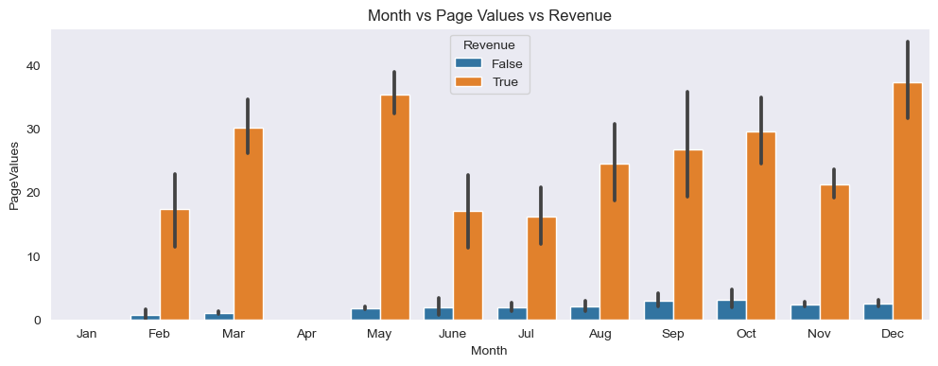
Month
80% vistors are coming in Top 4 months May, Nov, Mar and Dec. It may be because of festival sale and zero visitors in Jan and Apr.
Dec, May, Mar, Oct among top contributor to revenue.

Slide 20
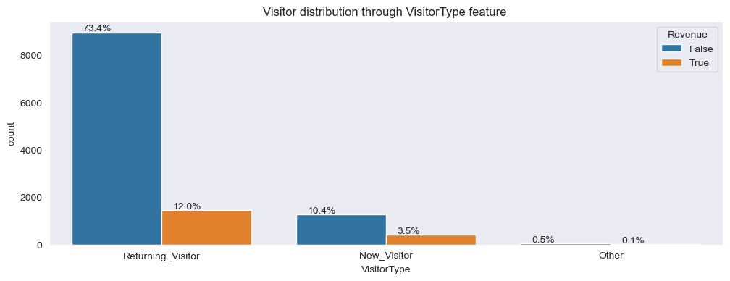
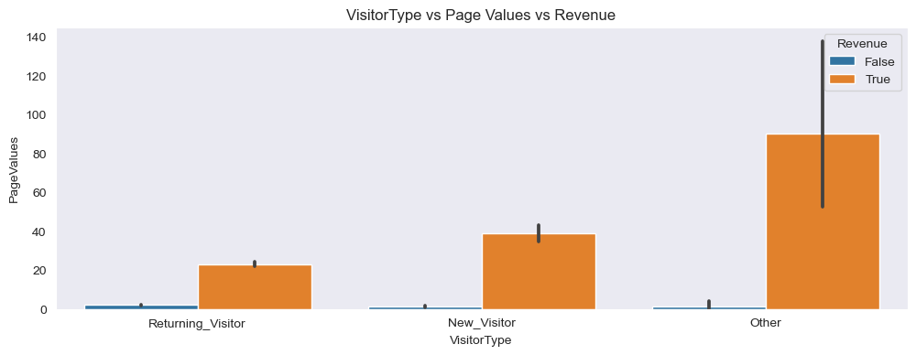
Visitor Type
Returning visitor type is 85%, which is a good thing
Other type visitor has max revenue and returning visitor has least
Provide coupon or offer based on revenue, so people visit again.

Slide 21
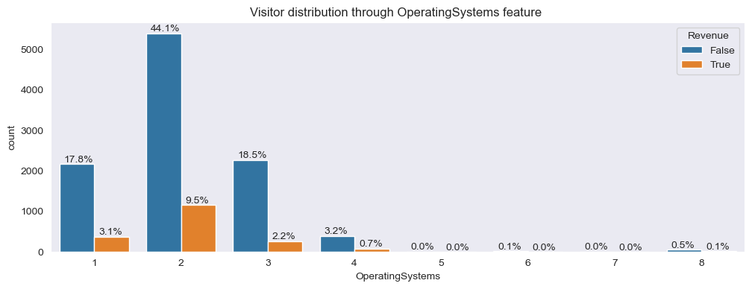
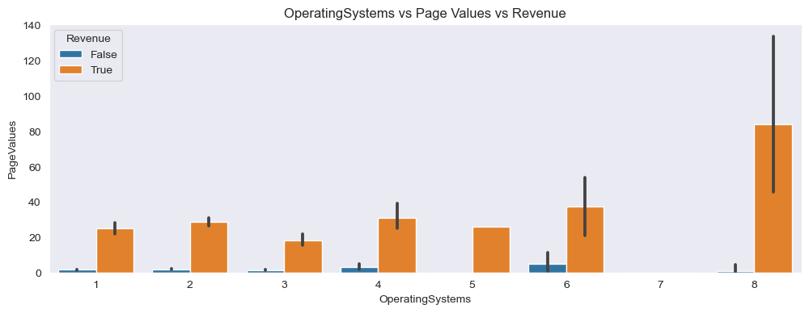
Operating System
95% visitors used operating system 1,2 and 3
8 type operating system visitor have max contribution and 7 type has least.
Optimize website for Top 3 operating system and no. 8.

Slide 22
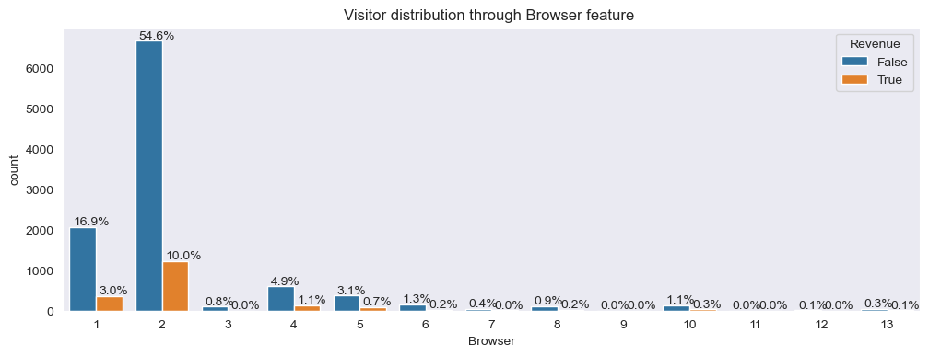
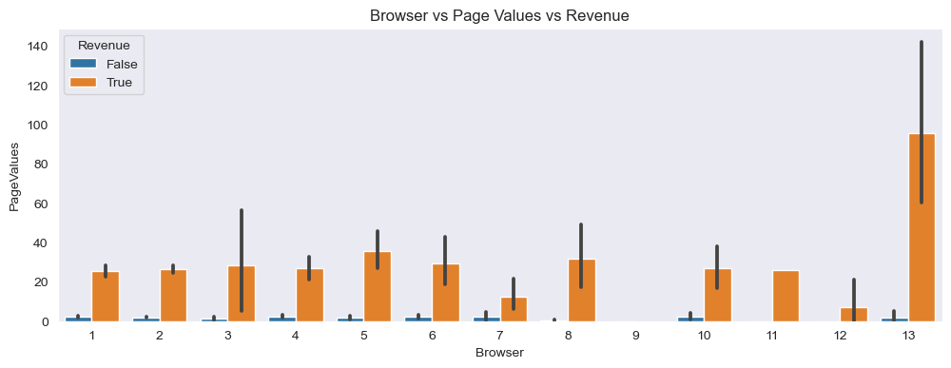
Browser
85% visitors are using browser 1 and 2
13 no. Browser has most contribution and 9 has least. otherwise for other browser revenue is almost uniform.
optimize website for Top 3 browser and 13

Slide 23
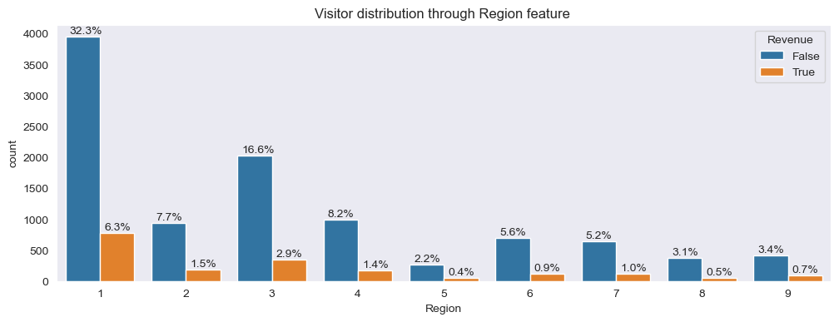
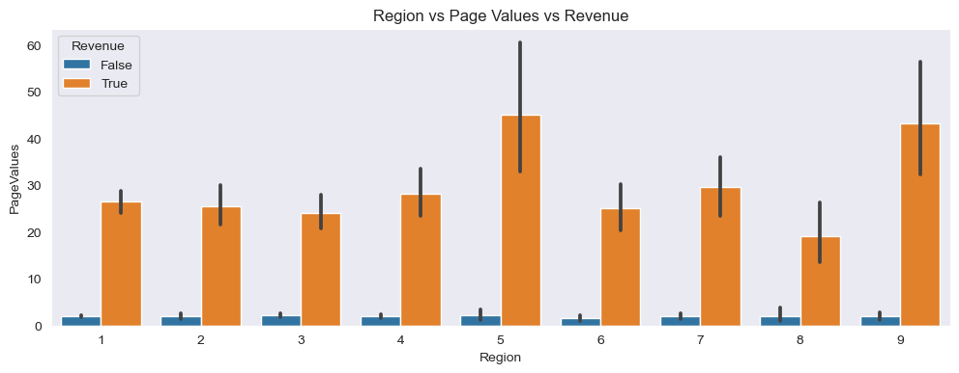
Region
83% of visitors are from top 5 regions 1,3,4,2 and 6
People from region 5 and 9 has top revenue generation for other region it is amlost uniform.
We can provide recommend region specific deals and products.

Slide 24
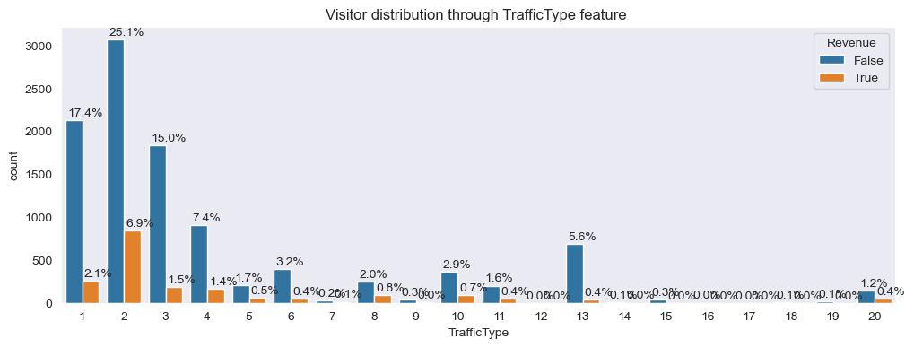
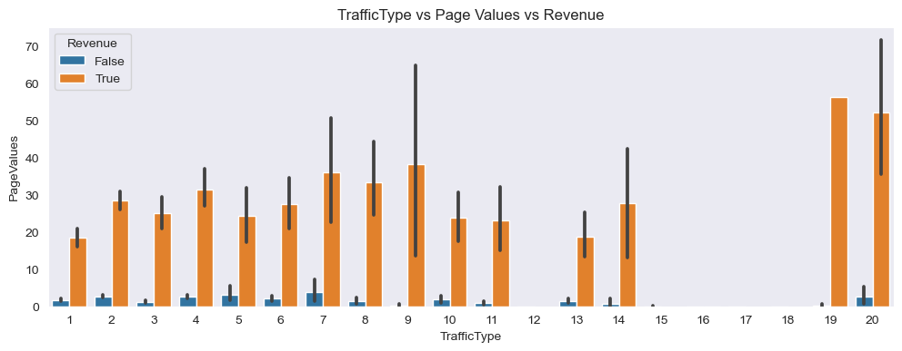
Traffic Type
82% visitors came from Top 5 Traffic type 1,2,3,4 and 13
19 and 20 traffic type generating most average revenue on the other hand traffic from 12, 15, 16,17 and 18 are not generating any.
Increase investment in 19 and 20 Traffic type.

Slide 25
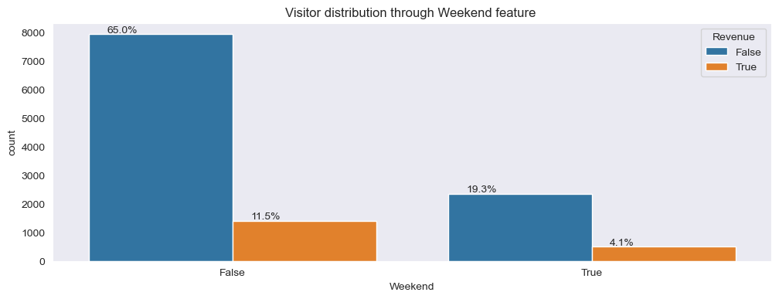
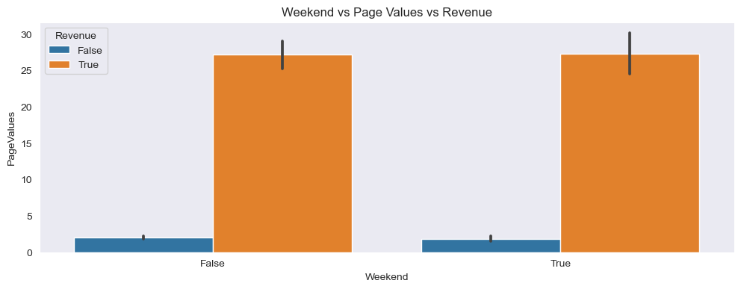
Weekend
only 23% visitors are on weekend, so website is approx equally visited irrespective of days.
weekdays and Weekend revenue is almost same.

Slide 26
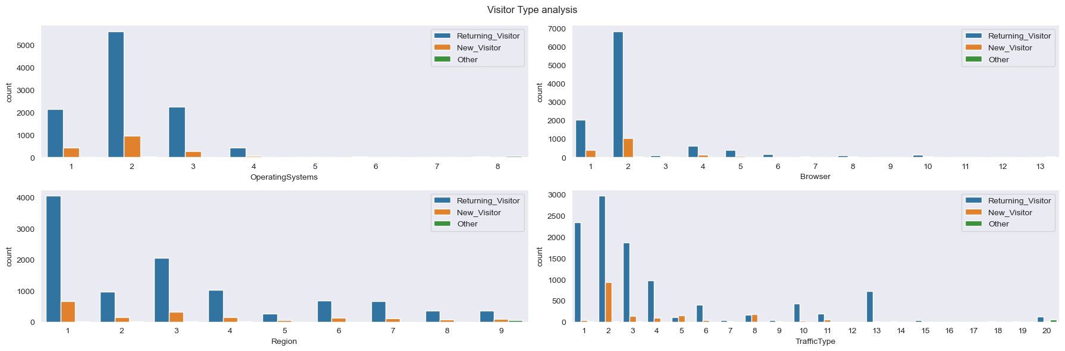
Visitor Type Analysis
Most New Visitor are using operating system no. 2 and browser 2.
Most New Visitor are coming from Region 1.
Traffic Type 2 is successful in getting New Visitors.

Slide 27
Predictive Model building

Slide 28
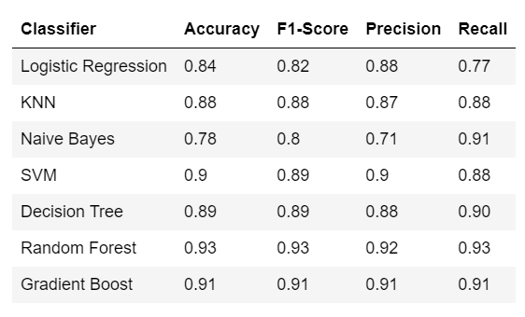
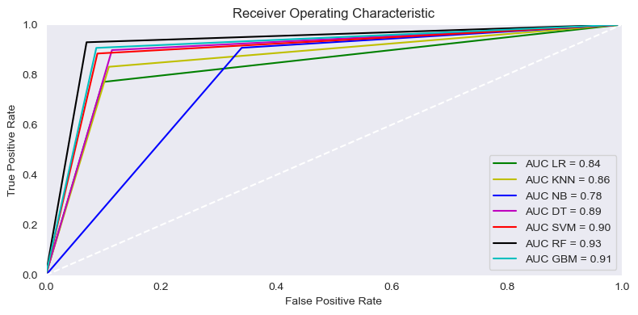
We build 7 different machine learning model to classify intention of visitor. By comparing different metrics its clear Random Forest is performing best.
ROC Curve - ROC curve is a model selection metric for class classification problems.
Random Forest model have highest area under Curve.

Slide 29
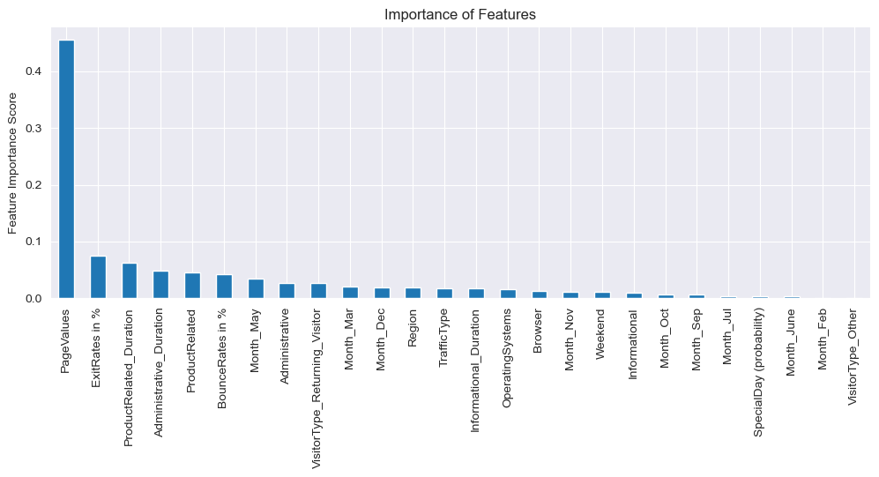
Feature Importance
PageValues feature has highest importance score because it has moderate relation with Revenue feature.

Slide 30
Key Analysis Points
Initial Pages have high average Bounce and Exit rate and less average duration spent. Optimize initial pages so visitor spent more time.
Some Product Pages have low average Bounce and exit rate but have good average Page Value. We can analyze these pages to improve other pages.
47 Product pages are generating zero revenue inspite of having visitors, we can analyze further to remove these pages or optimize. These pages are following :
(144, 158, 174, 180, 188, 191, 204, 207, 210, 211, 217, 231, 232, 235, 246, 247, 250, 251, 254, 256, 260, 262, 272, 274, 275, 281, 283, 286, 290, 305, 309, 311, 315, 326, 330, 337, 339, 340, 343, 358, 362, 377, 378, 385, 449, 486, 518)
Need to analyze why there are no visitors in Jan and April month.
Optimize website for better experience on Top 3 operating system and browser based on average revenue.

Slide 31
Conclusion
recommend region specific products and offer to region which have less visitor but have good average Page Value.
Increase investment in TrafficType which have less visitors but have good page values like 19 and 20 traffic type and generating New visitor like Traffic type 2.
In this project, we used ‘Online Shoppers Intention’ dataset to analyze and build models that can classify website visitor, and predict which of them is likely going to make a purchase on the website. 7 different classifiers were built, and the best classification performance is by Random Forest model, followed by Gradient Boost model.
The best classification performance: Accuracy: 93% F1 Score: 0.93

Slide 32
Thank You

